Slide 1
Intermediate-Code Generation
Chapter 6

Slide 2
Section: 6.1 | Page: 357 - 361
Section: 6.2 | Page: 363 - 369, excluding 6.2.4
Class Lecture / Slide

Slide 3
Intermediate-Code
Intermediate Code
Front End
Back End
Source Program
for Language i
Target Code
for Machine j

Slide 4
Outlines
Intermediate Representation
  Syntax tree / DAG – close to source language
  Three Address Code – close to target machine
Static Checking
  Type checking
    Representing Type: Type Expression
    Collecting type information from Declaration
Generating Intermediate Code
  Three address code
  Using SDD

Slide 5

Variants of Syntax Trees
Syntax Tree
  Each node represents a construct of source program
  Each children represent a meaningful component
Syntax Tree for expression 9-5+2
Leaves correspond to atomic operands
Interior nodes correspond to operators

Slide 6
DAG – Directed Acyclic Graph
Detect common subexpression
  Produce only one subtree for each subexpression
Let an expression : a + a
+
+
a
a
a
Node for a is created once
Common Subexpression

Slide 7
DAG
A node N may have more than one parent.
  No replication of any node
  Represents expression more succinctly
  Important clues for efficient code generation
  Consider an example a + a * (b - c) + (b - c) * d

Slide 8
DAG – Elaborate Example
  a + a * (b - c) (b - c) * d
+
*
+
-
d
a
*
b
c
a
-
b
c

Slide 9
DAG – Elaborate Example
+
+
*
*
+
-
+
d
*
d
a
*
b
c
a
-
a
-
b
c
b
c

Slide 10
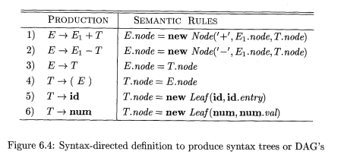
SDD for Constructing DAG
No difference from SDD for syntax tree !!!

Slide 11
DAG Construction
Before creating a new node
  Check whether an identical node already exist
  If so the existing node is returned.
  For instance
    Before constructing a new node Node(op, left, right) check whether a node already exist with
      label op
      Children left and right with that order

Slide 12
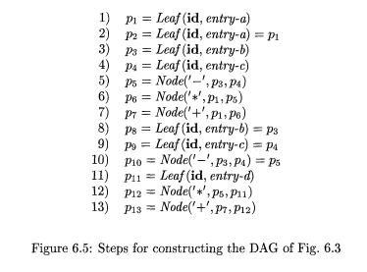
Steps for DAG construction
  a + a * (b - c) (b - c) * d
+
*
+
*
d
a
-
b
c

Slide 13
Value Number Method
An approach to create DAG with array of records
  Each row (record) represents one node
In each record
  First field is an operation code (label of that node)
  Leaves have a field containing lexical value
  Interior nodes have two additional field
    The left and right children

Slide 14
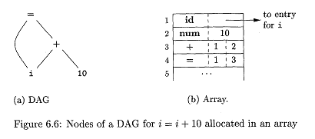
Value Number Method - example

Slide 15
Value Number
Reference of a node is the index for that node within the array
  This is called the value number for that node

Slide 16
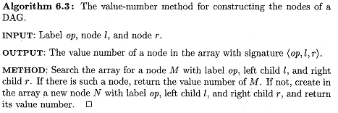
Algorithm

Slide 17
Three Address Code
There is at most one operator on the right side of an instruction
  No arithmetic expressions
  Ex: for expression x + y * z ..
    t1 = y * z
    t2 = x + t1

Slide 18
Three address Code and DAG
Is a linearized representation for DAG
  Explicit name corresponds to the interior nodes
  Each instruction in the sequence has a label
+
t5
t4
t1 = b - c
t2 = a * t1
t3 = a + t2
t4 = t1 * d
t5 = t3 + t4
t3
*
+
t2
d
*
a
-
t1
b
c

Slide 19
Three Address Code
Built from two concept
  Address
    What address can be used in the code
  Instruction
    What kind of instruction set can be applied.

Slide 20
Address
A name: Source program names
  May be pointer to symbol table entry
A constant
A compiler generated temporary

Slide 21
Instructions
Assignment instructions
  x = y op z where x, y, z are addresses and op is a binary operator
  x = op y where op is a unary operation
Copy instruction: x = y
  x is assigned the value of y
An unconditional jump : goto L
  Instruction with label L is executed next
Conditional jumps:
  if x goto L
  ifFalse x goto L
  if x relop y goto L

Slide 22
Instructions
Procedure calls and returns:
  param x for parameters
  call p, n or y = call p, n for procedure/function calls
  return y represent returning a value
  For procedure proc(x₁, x₂, ..., x_{n})
  param x₁
  param x₂
  ...
  param x_{n}
  call proc,n

Slide 23
Instructions
Indexed copy instructions:
  x = y[i] sets x to the value in the location i memory units beyond location y.
  x[i] = y sets the contents of the location i units beyond x to the value of y
Address and Pointers assignments:
  x = $ y
  x = * y
  * x = y

Slide 24
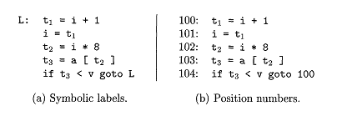
Examples
Consider the statement
  do i = i + 1; while (a[i] < v)

Slide 25
Representation of Three Address Code
Now the question is
“ How can we represent these instruction in a data structure”.
In a compiler it can be implemented as objects or as records with field for operation and operands.
Three such representation
  Quadruples
  Triples
  Indirect Triples

Slide 26
Quadruples
Quadruple has four fields
  op field to represent operation
  arg₁, arg₂ for holding operands
  result to hold the result of the operation
class three_address_code {
    char * op;
    char* arg1,arg2;
    Char* result;
    }

Slide 27
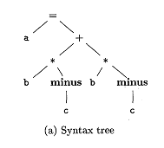
Examples
Consider a = b * -c + b * -c
Op arg1 arg2 result
0
minus | c |  | t1
* | b | t1 | t2
minus | c |  | t3
* | b | t3 | t4
+ | t2 | t4 | t5
= | t5 |  | a
1
2
t1 = minus c
t2 = b * t1
t3 = minus c
t4 = b* t3
t5 = t2 + t4
a = t5
3
4
5
Quadruples
Three Address Code

Slide 28
Triples
A triple has only three fields
  op : operation
  arg₁,arg₂ : operands
No result field
  Refer to the result of an operation by its position in the triple structure.

Slide 29
Examples : Triples
Consider again a = b * -c + b * -c
Op arg1 arg2
0
minus | c
* | b | (0)
minus | c
* | b | (2)
+ | (1) | (3)
= | a | (4)
1
t1 = minus c
t2 = b * t1
t3 = minus c
t4 = b* t3
t5 = t2 + t4
a = t5
2
3
4
5
Prob: Reordering the code sequence

Slide 30
Indirect Triple
Instruction
Op arg1 arg2
(0)
(1)
(2)
(3)
(4)
(5)
0
minus | c
* | b | (0)
minus | c
* | b | (2)
+ | (1) | (3)
= | a | (4)
1
2
3
4
5
...

Slide 31
Summery
Variants of intermediate code
Syntax tree
  DAG
  Value number method to represent DAG
Three address Code
  Instruction set
  Three different representation

